Slide 1
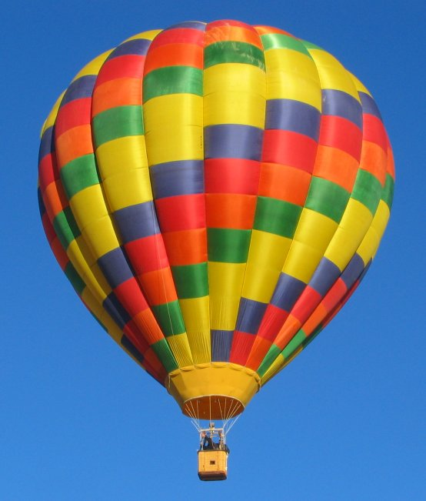
Measuring Motion
Unit 7
Section 1

Slide 2
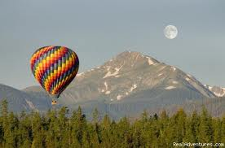
I. Motion
MOTION is an object’s position relative to a reference point.
A REFERENCE POINT is the object that appears to stay in place when something else is moving.
1. An example would be how you can tell an air balloon is moving by looking at a motionless object next to it, like a mountain.

Slide 3
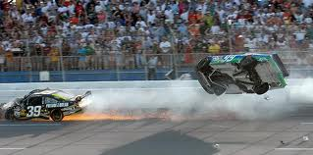
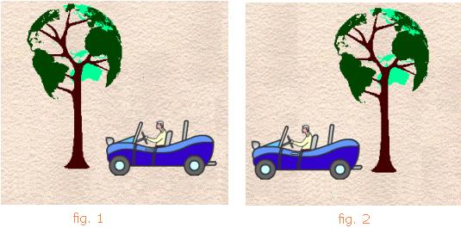
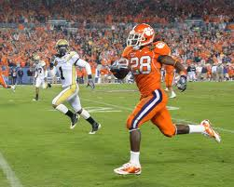
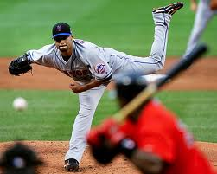
Can you think of any other examples of a reference point?

Slide 4
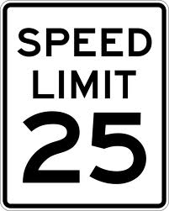
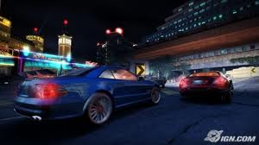
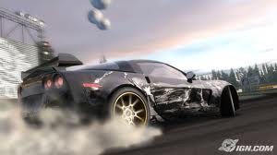
II. Speed
SPEED is the distance traveled divided by the time it took to travel it.
Average speed = total distance total time
Speed is usually expressed in meters per second (m/s).

Slide 5
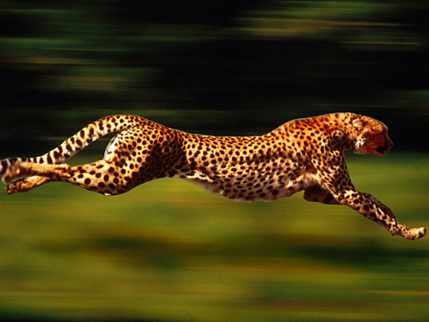
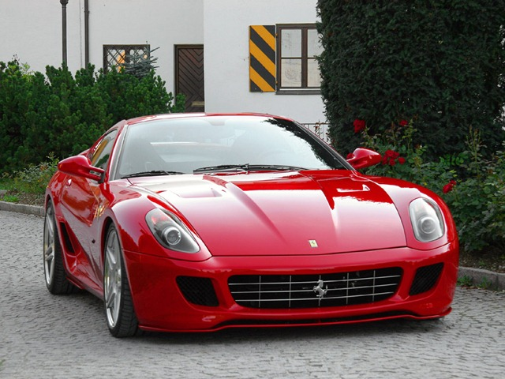
III. Velocity and Acceleration
VELOCITY is the speed of an object IN a particular direction. It is different from speed, because it includes the direction of an object.
ACCELERATION is the rate at which velocity changes over time. If an object speeds up, slows down or changes direction, it is accelerating.

Slide 6
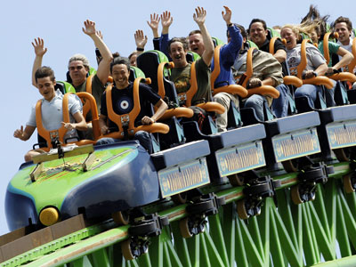
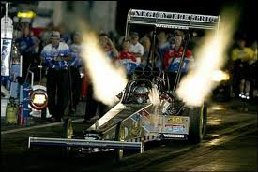
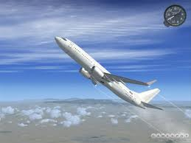
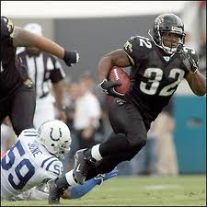
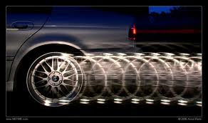
What are some things that accelerate?

Slide 7
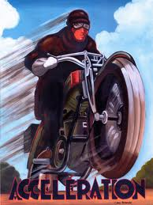
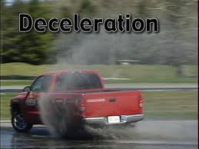
IV. Acceleration and Deceleration
An increase in velocity is known as POSITIVE ACCELERATION.
A decrease in velocity is known as NEGATIVE ACCELERATION or DECELERATION.

Slide 8
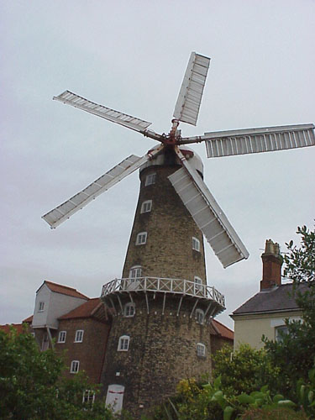
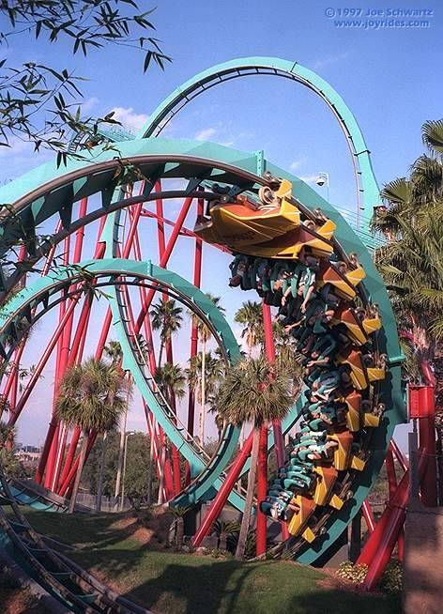
V. Centripetal Acceleration
When acceleration occurs in a circular motion, such as a windmill spinning, it is CENTRIPETAL ACCELERATION.

