Slide 1
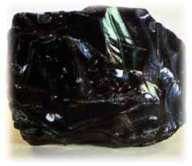
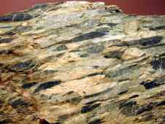
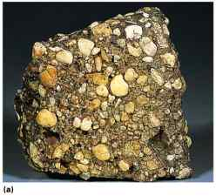
Rocks

Slide 2
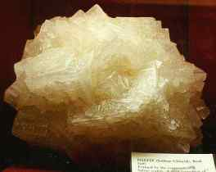
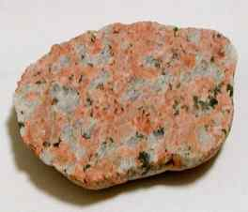
Poly-mineralic
Mono-mineralic
made of
two or more
minerals
made of
one mineral

Slide 3
Three Classifications
of Rocks are:
igneous
sedimentary
metamorphic

Slide 4
Sedimentary Rocks
Most sedimentary rocks are made of pieces
of other rocks.
Image #2
Image #1

Slide 5
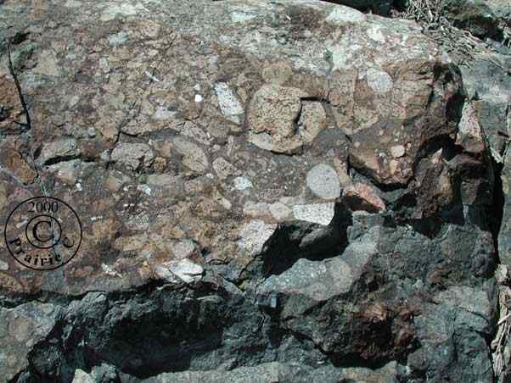

Slide 6
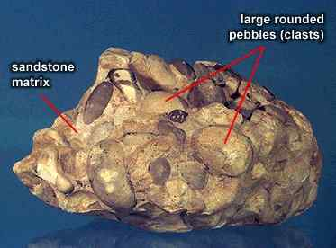

Slide 7
Name two processes that
form sedimentary rocks
Compression
Cementation
clasts held
together by
minerals
(cement)
the weight of
overlying sediments
forces particles
together

Slide 8
In what type of environment are most
sedimentary rocks formed?
watery

Slide 9
Key Identifying Features of
Sedimentary Rocks
Strata
Clear Layering of Sediments
Image #1
Image #2
Image #3

Slide 10
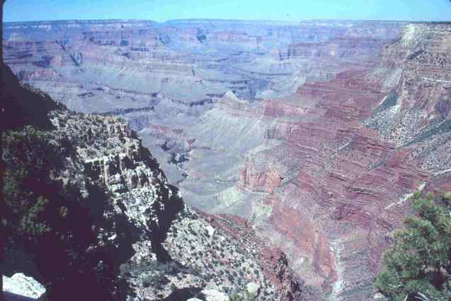

Slide 11
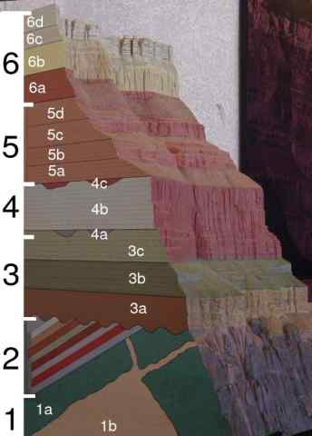

Slide 12
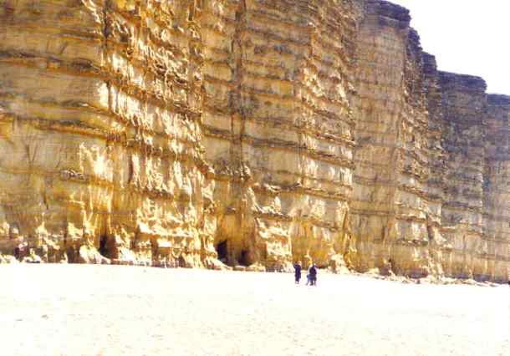

Slide 13
Key Concept #4
Key Identifying Features of
Sedimentary Rocks
pieces of other rocks
Image #2
Image #1

Slide 14
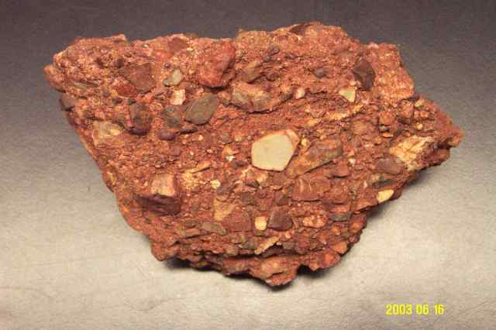

Slide 15
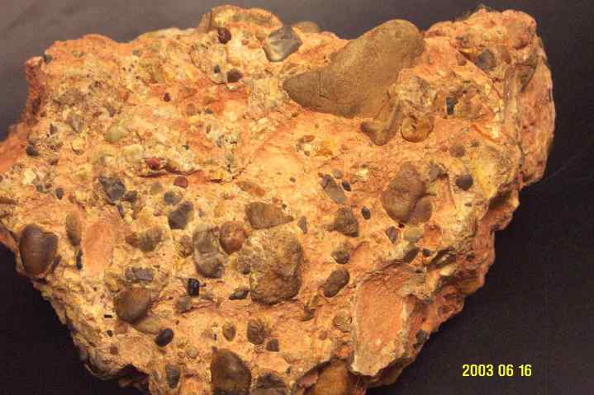

Slide 16
Key Identifying Features of
Sedimentary Rocks
Fossils
the remains of once-living organisms
Image #1
Image #3
Image #4
Image #2

Slide 17
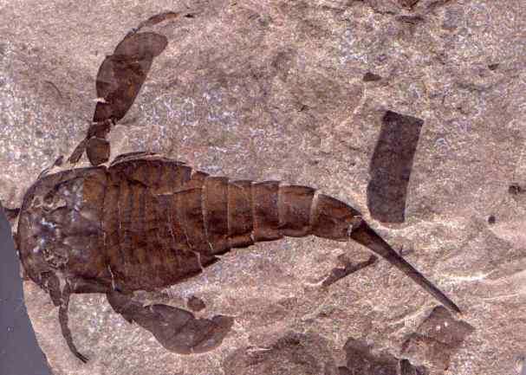

Slide 18
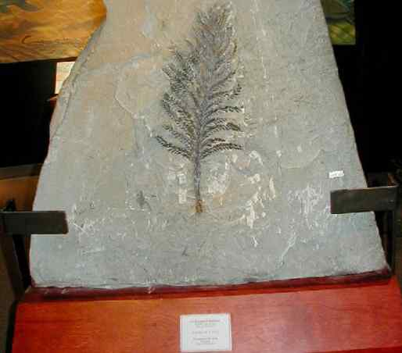

Slide 19
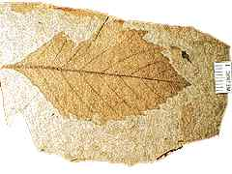
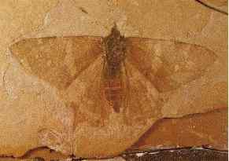
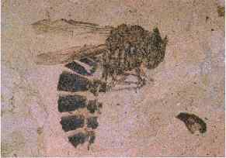

Slide 20
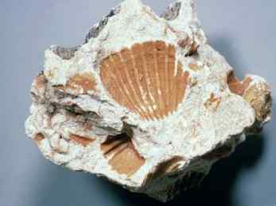
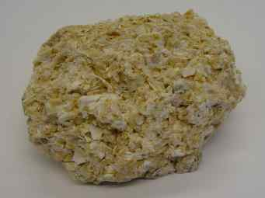

Slide 21
Igneous Rocks
©Mark Place, 2008-2009
www.LearnEarthScience.com
Edited by: Mr. Barbera, Mrs. Perun and Mrs. Curry

Slide 22
Igneous Rocks
How are igneous rocks formed?
the melting and
solidification of
magma

Slide 23
Igneous Rocks:
Name two places where igneous rocks form

Slide 24
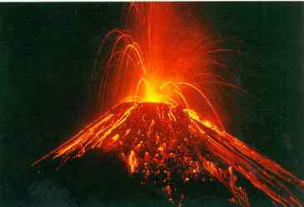
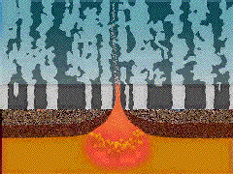
Volcanoes
Rifts/Ridges

Slide 25
Igneous Rocks:
What determines crystal size?

Slide 26
cooling time

Slide 27
crystal size
cooling time

Slide 28
Large Crystals Indicate
long cooling time
Small Crystals Indicate
short cooling time

Slide 29
Coarse-grained v. Fine-Grained
COARSE GRAINED ROCKS
FINE GRAINED ROCKS
Formed inside the earth -INTRUSIVE
Cool slowly inside the earth because it is hot
Creates LARGER CRYSTALS which are called COARSE
EX: SALT on Pretzels is very large – coarse grained
Formed outside of the earth – EXTRUSIVE
Cool quickly (SHORT TIME) outside because of the cool air
Creates SMALL CRYSTALS which are called FINE GRAINED
EX. Table Salt – fine grained

Slide 30
Igneous Rocks:
What’s the difference between
extrusive and intrusive igneous rocks?

Slide 31
Extrusive
Intrusive
form on or near the
surface
(small crystals)
form below the
surface
(large crystals)

Slide 32
Igneous Rocks:
Characteristics used to classify igneous rocks

Slide 33
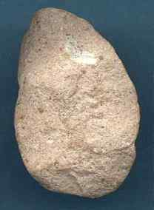
Characteristics used to classify igneous rocks
texture
glassy
}
extrusive
fine

Slide 34
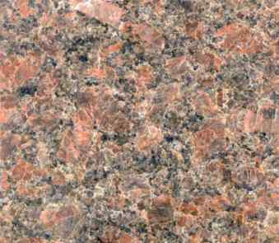
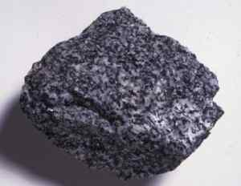
Characteristics used to classify igneous rocks
texture
coarse
}
intrusive
very coarse

Slide 35
Characteristics used to classify igneous rocks
density
low
high

Slide 36
Igneous Rocks:
Key Identifying Features of Igneous Rocks

Slide 37
Glassy Texture
usually black in color
Interlocked Grains
the grains have been melted
and are now physically connected

Slide 38
Metamorphic Rocks Rocks & Minerals Notes:
©Mark Place, 2008-2009
www.LearnEarthScience.com
Editted by: Mr. Barbera, Mrs. Perun and Mrs. Curry

Slide 39
Metamorphic Rocks
How are metamorphic
rocks formed?
extreme heat
and/or
pressure

Slide 40
Metamorphic Rocks
If melting occurs,
it is classified as
an
MELTING DOES NOT OCCUR!
Igneous Rock

Slide 41
Metamorphic Rocks: Key Concept #3
What is the difference between
Regional and Contact Metamorphism?

Slide 42
Regional Metamorphism
Large geographic area
Example:
where mountains form

Slide 44
Contact Metamorphism
small geographic area
Example:
when rocks come in
contact with magma

Slide 45
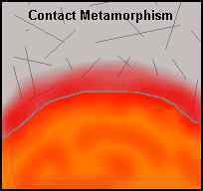

Slide 46
Foliation
Image #1
Image #2
banding of minerals
usually black and white
Image #3

Slide 47
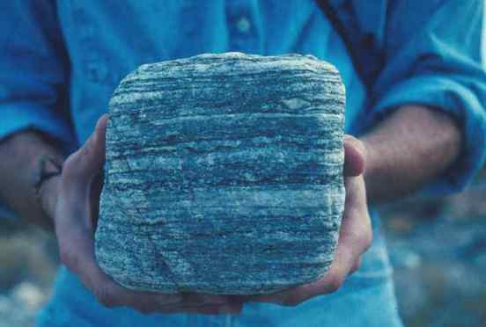

Slide 48
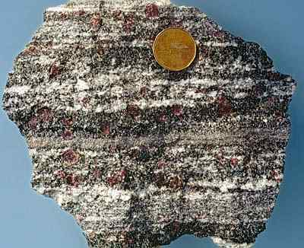

Slide 49
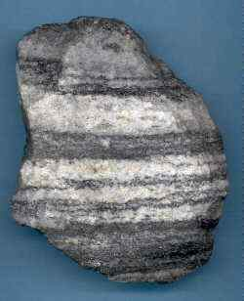

Slide 50
Distorted Structure
folded layers
Image #3
Image #1
Image #2

Slide 51
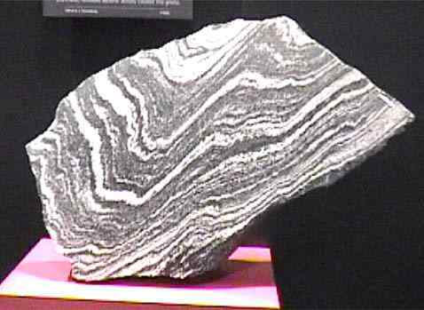

Slide 52
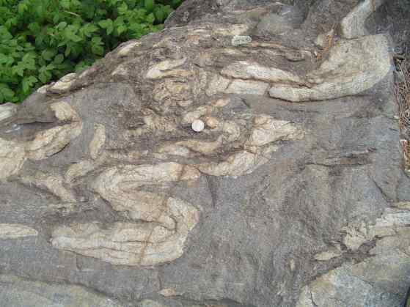

Slide 53
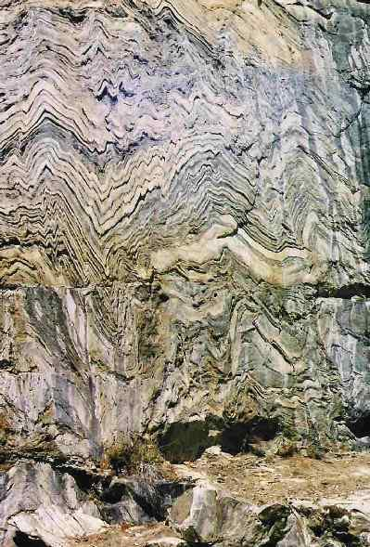

Slide 54
Key Identifier Minerals
Dark
Red
Color
Garnet
Shiny,
flaky
Mica

Slide 55
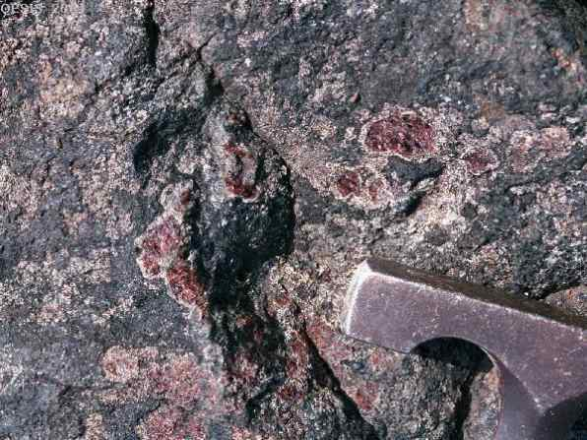

Slide 56
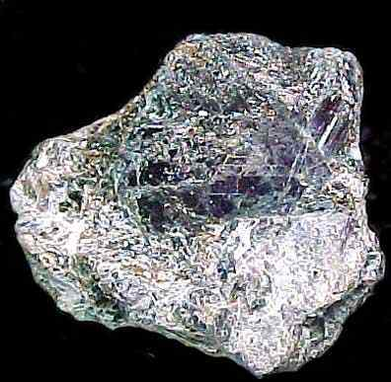

Slide 57
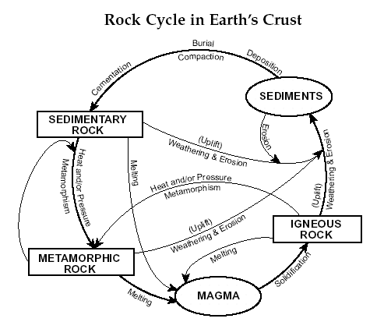
THE ROCK CYCLE

Slide 58
SEDIMENTARY ROCK REVIEW
ROCKS ARE CLASSIFIED BY HOW THEY FORM
Processes that form sedimentary rocks | Compaction and Cementation
Always form in horizontal layers called: | STRATA
Always form in or near: | Watery Environments
May contain animal remains called: | Fossils

Slide 59
IGNEOUS ROCK REVIEW
ROCKS ARE CLASSIFIED BY HOW THEY FORM!!
Processes that forms IGENOUS rocks | Melting and Cooling (Solidification)
Always forms from: | MAGMA or LAVA
Always form in or near: | Volcanoes
If it forms outside of earth’s surface it is: Therefore it cools quickly – result is→ (Small crystals = SHORT cooling time) | EXTRUSIVE Fine Grained crystals
If it forms INSIDE the earth it is: Therefore it cools SLOWLY – RESULT IS→ (Large crystals = LONG Cooling Time) | INTRUSIVE Coarse Grained Crystals

Slide 60
METAMORPHIC ROCK REVIEW
ROCKS ARE CLASSIFIED BY HOW THEY FORM!!
Processes that forms METAMORPHIC rocks | HEAT and PRESSURE
Always forms: | DEEP UNDERGROUND (where it’s hot & there is lots of pressure)
Often have lines of minerals → | Foliated
If there are no lines of minerals → | Non-foliated
Before a Metamorphic rock CHANGED into a metamorphic rock was…… | A different type of rock – either igneous or sedimentary or even another metamorphic rock!

