Slide 1
Unit 2 Test Review
Notes:
Dana Kalachik

Slide 2
Unit 2 Test Review
Tools
Measurement
Density
Vocab
Units & Conversions
10
10
10
10
10
20
20
20
20
20
30
30
30
30
30
40
40
40
40
40
50
50
50
50
50

Slide 3
This tool is used to measure distance or length.
Answer: What is a metric ruler?

Slide 4
This tool is used to find the volume of liquids and gases.
Answer: What is a graduated cylinder?

Slide 5
This tool is used to measure the mass of an object.
Answer: What is a triple beam balance?

Slide 6
This tool is used to find the volume of a REGULAR shaped solid.
Answer: What is a metric ruler?

Slide 7
This instrument is used to measure the volume of an IRREGULAR shaped object.
Answer: What is a graduated cylinder?

Slide 8
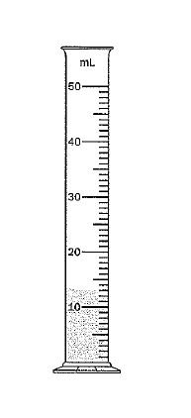
Answer: What is 13.0 mL?

Slide 9
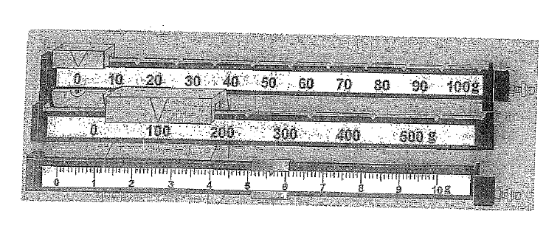
Answer: What is 105.6 grams

Slide 10
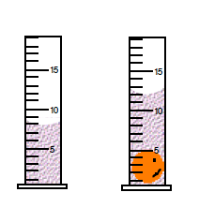
Answer: What is 4.0 cc/cm3

Slide 11
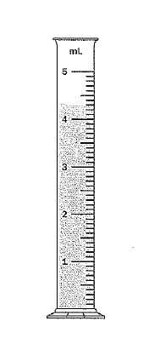
.
Answer: What is 4.3 mL?

Slide 12
This is the measurement at point e.
Answer: What is 8.3 cm?

Slide 13
This is the density of water.
Answer: What is 1.0 g/cc?

Slide 14
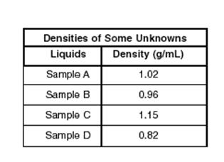
This would be the order of the sample’s densities from least dense to most dense.
Answer: What is Sample D, B, A, C?

Slide 15
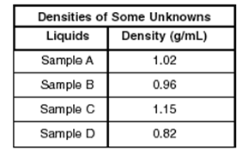
These 2 samples would sink if placed in water.
Answer: What are samples A and C?

Slide 16
This would be the density of an object that has a mass of 208 g and a volume of 4 cc.
Answer: What is 52.0 g/cc?

Slide 17
If I have a brick with a density of 8.0 g/cc and I cut it into 4 equal pieces, this would be the density of each brick .
Answer: What is 8.0 g/cc? DENSITY NEVER CHANGES

Slide 18
This is the curve at a liquid’s surface by which one measures the volume of the liquid.
Answer: What is the meniscus?

Slide 19
An observation we make using a tool .
Answer: What is a measurement?

Slide 20
The ratio of the mass of a substance to the volume of the substance.
Answer: What is density?

Slide 21
A system of units based on the meter as a unit length, the gram as a unit mass, and the liter as a unit for volume. Uses multiples of 10.
Answer: What is the metric system?

Slide 22
The difference in volume when an irregular object is placed in a graduated cylinder.
Answer: What is water displacement?

Slide 23
This is the unit we use when measuring LIQUIDS in the metric system.
Answer: What are liters?

Slide 24
This is the unit we use when measuring DISTANCE/LENGTH in the metric system .
Answer: What are meters?

Slide 25
This is the unit we use when measuring the MASS of an object.
Answer: What are grams?

Slide 26
198 cm = ________ m
Answer: What is 1.98 m?

Slide 27
6 g = ________ kg.
Answer: What is 0.006kg ?

