Slide 1
Unit 2-4
DENSITY!

Slide 2
Defined:
MASS per unit of VOLUME
What is DENSITY?
or
The amount of matter in a given space
2
Notes:
2

Slide 3

What does that mean?
How heavy something is compared to its size
Is it big and heavy, small and light, etc….
3

Slide 4
Which is heavier……..
100 pounds of feathers
or
100 pounds of lead?
They're the SAME!
But which would take up more room????
4

Slide 5
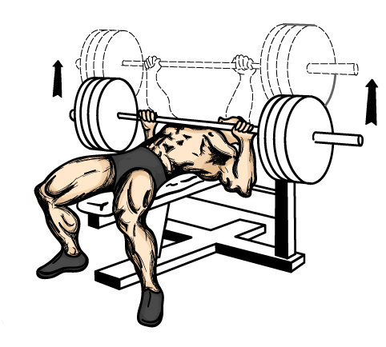
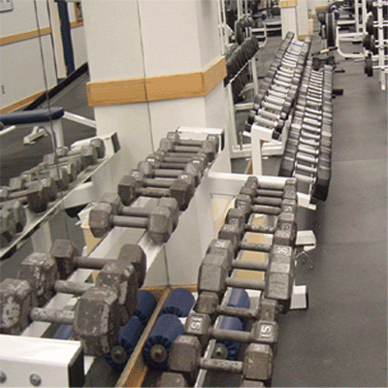

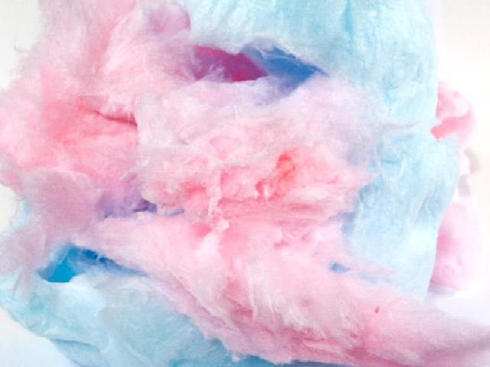
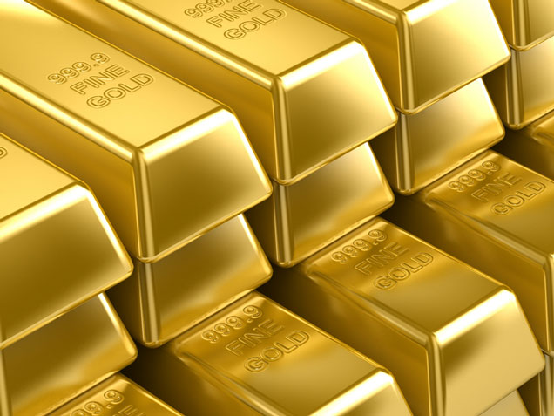
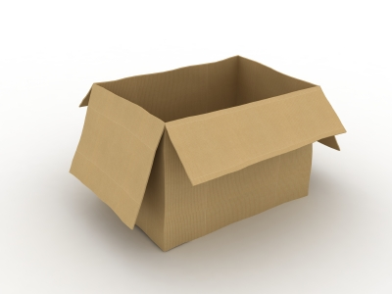
Consider these…..
5

Slide 6
Some Facts:
- Density is a PHYSICAL PROPERTY
- That means it can be OBSERVED
Remember: it is specific to individual substances!
  Ex: the density of gold is always 19.3 g/cc
  You can tell what an unidentified
  substance is by finding its density.
6

Slide 7
The FORMULA:
“Density equals mass divided by volume”
m
d
=
v
m
d
v
7

Slide 8
Something IMPORTANT
Density will ALWAYS remain the same.
If you cut an object, the density is still the same.
  WHY?
Because if you cut an object in half, the mass is halved and so is the volume.
m
d
=
v

Slide 9
WHY?
Because density will always reduce to the same answer
Consider This…..
L= 5 cm W = 2 cm H = 4 cm
L= 2.5 cm W = 1 cm H = 2 cm
Cut in half…..
100 grams
50 grams
9

Slide 10
Very Important!
NEVER
DENSITY CHANGES!!!
So……
m
d
Density never changes. Since this is a fraction, when we change the top we change the bottom as well.
=
v
10

Slide 11


EXAMPLE:
100 mL of water has a mass of 100 g.
The density of water is 1 g/ml.
Now dump out one half (½) of the water…….
Can you do that and still
have water have a density of 1g/ml?
The math:
100 g = 1 g/ml = 200 g = 1 g/ml = 50 g
100 ml 200 ml 50 ml
11

Slide 12
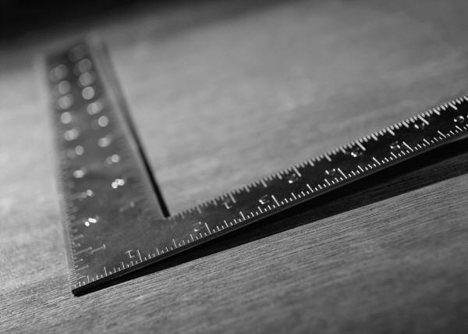


Where do the UNITS of density come from?
The units of density come from the calculations that you make.
Remember that you cannot measure density,
you can only calculate it using the formula.
12

Slide 13
Here’s how it works:
measured in
m
g
d
=
v
3
cm
measured in
13

Slide 14
The other units of density:
g
g
g
or
or
cm
3
mL
cc
Remember: cc = mL = cm³
But your units should reflect whatever units were given in the problem.
14

Slide 15
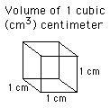
mL = cc = cm³
The volume of this cube is 1 cm³
If we fill this cube with water it would hold 1mL
Therefore
1 mL = 1 cc = 1cm³
15

Slide 16
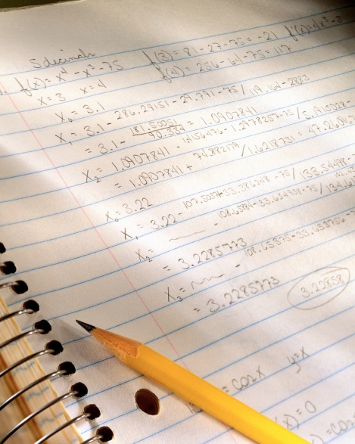
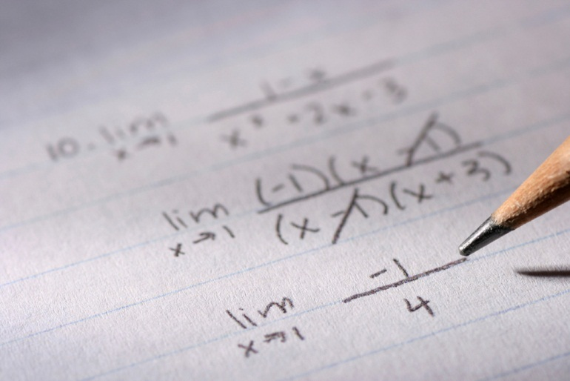
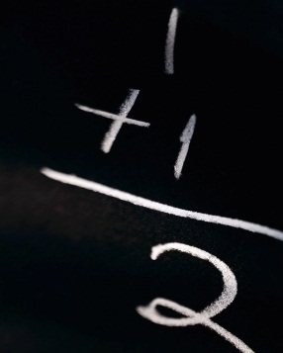
Show your work…..
1st make a list of what you’re given
2nd write your formula
3rd fill in your formula
remember to include the UNITS!
4th plug your numbers into the calculator
5th Record your answer, again remember to include the units!
ROUND TO THE NEAREST TENTH (.1)
16

Slide 17

Here’s how it should look:
What is the density of carbon dioxide gas if 0.250 grams
occupies a volume of 25 mL?
The List
The Formula
D =
M = 0.250 g
V = 25 mL
m
0.250 g
d
=
=
=
0.01
g
v
25 mL
mL
17

Slide 18
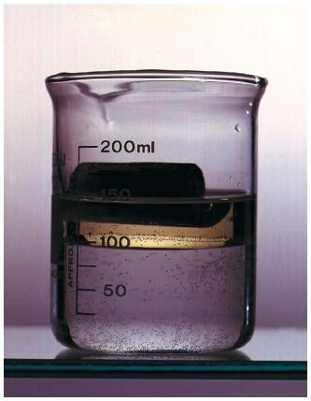

Sink or Float?????
Because the density of liquid water is always 1 g/cc we can predict if objects will sink or float depending upon their density…..
Density of .3 g/cc
Density of
1 g/cc
Density of
.5 g/cc
Density of 1.9 g/cc
18

Slide 19

Remember the Magic Potato?
A
B
C
0.1% salt. Density is close to 1 g/ml.
50% salt. Density is about 1.1 g/ml.
100% salt. Density is close to 1.2 g/ml.

Slide 20
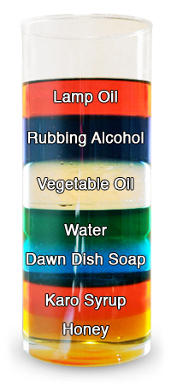
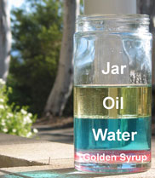


Density Columns
20

