Slide 1
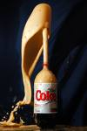
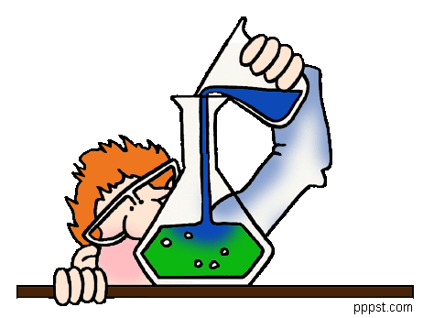
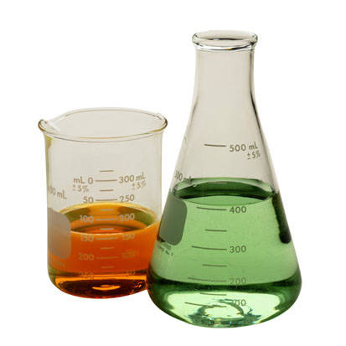

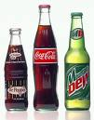
Solutions!

Slide 2
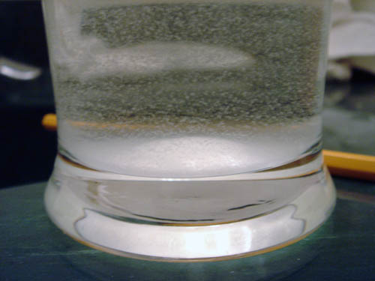
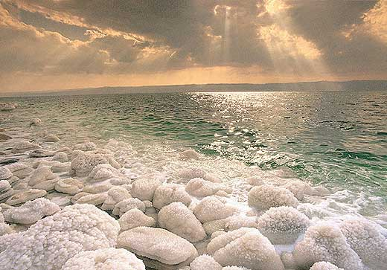
1. What is a solution?
A solution is a type of homogeneous mixture formed when one substance dissolves in another.
It is evenly mixed and does not settle out.
Can’t see the different particles
Solutions can be mixtures of solids, liquids, or gasses!

Slide 3
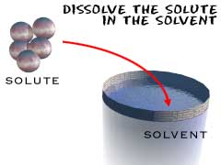
2. What makes up a solution?
A solute is the substance that is being dissolved.
  It is usually in the SMALLER amount
A solvent is the substance that does the dissolving
  It is usually in the LARGER amount

Slide 4

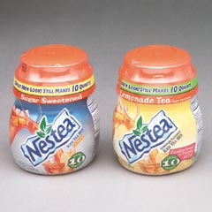
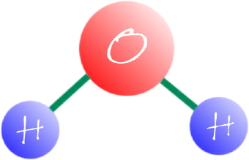
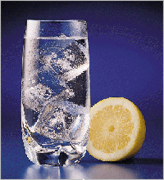
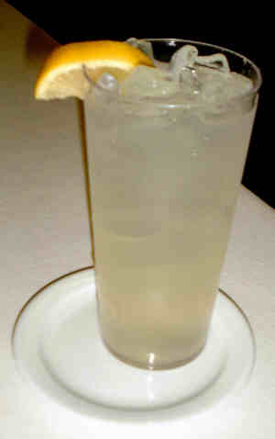
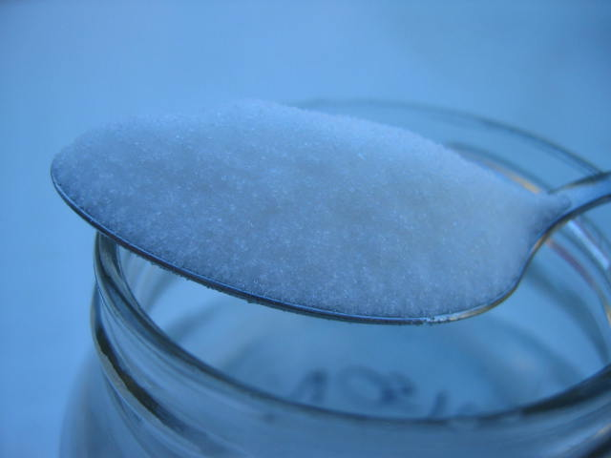
Examples
Solvent
Solution
Solute

Slide 5
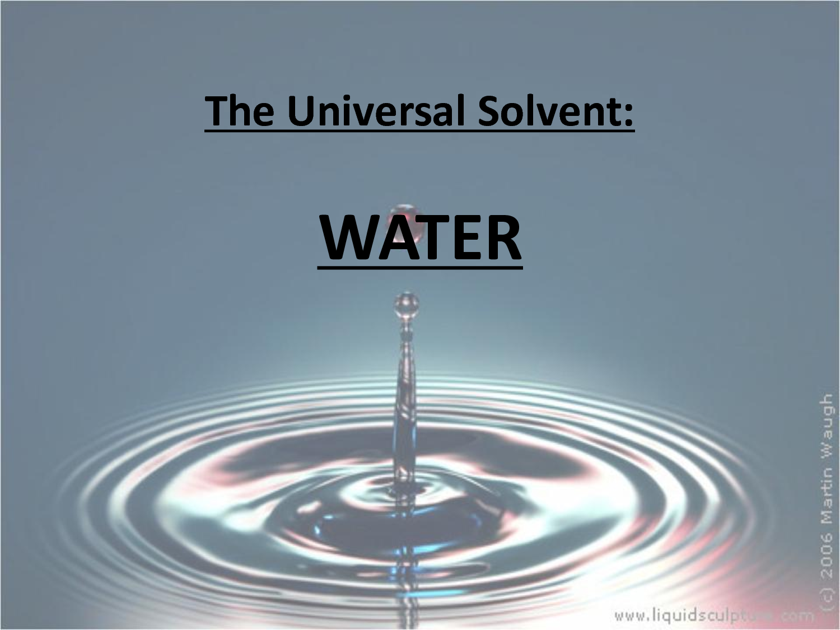

Slide 6
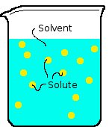
3. Concentration
Concentration refers to how many solute molecules are present in a solvent.
It is how much “stuff” is in a place.
We use descriptive words to identify concentrations of solutions:
  Dilute
  Concentrated
  Saturated

Slide 7
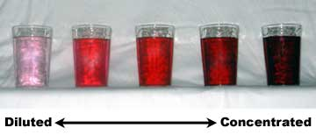
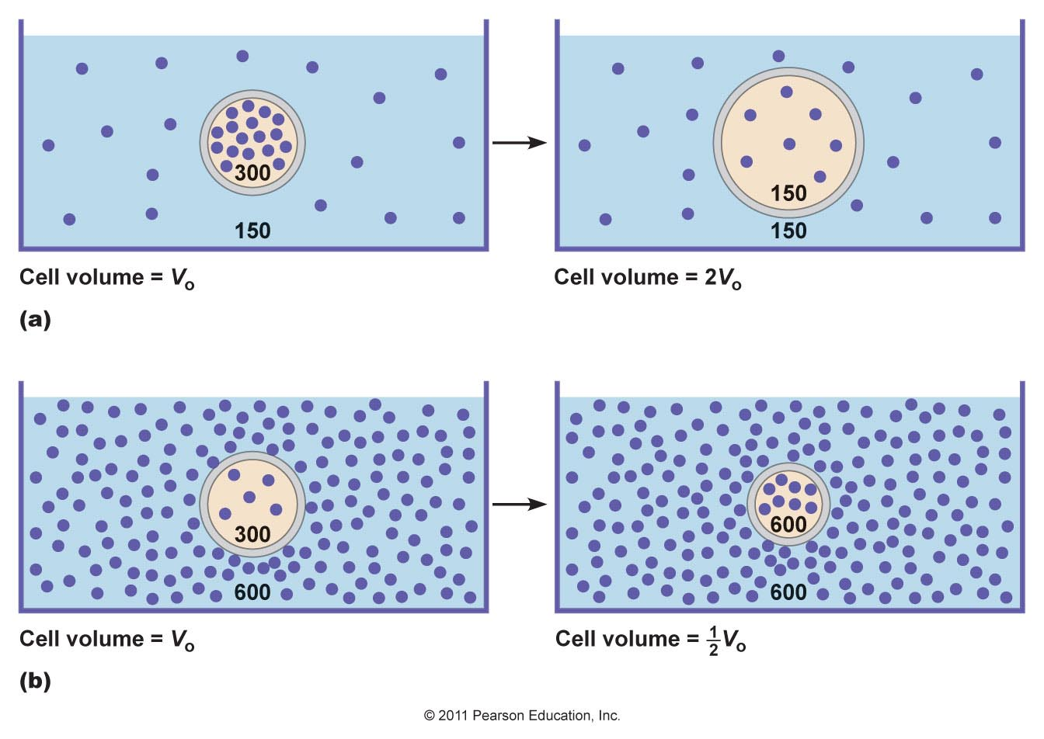
Key:
Solute particles

Slide 8
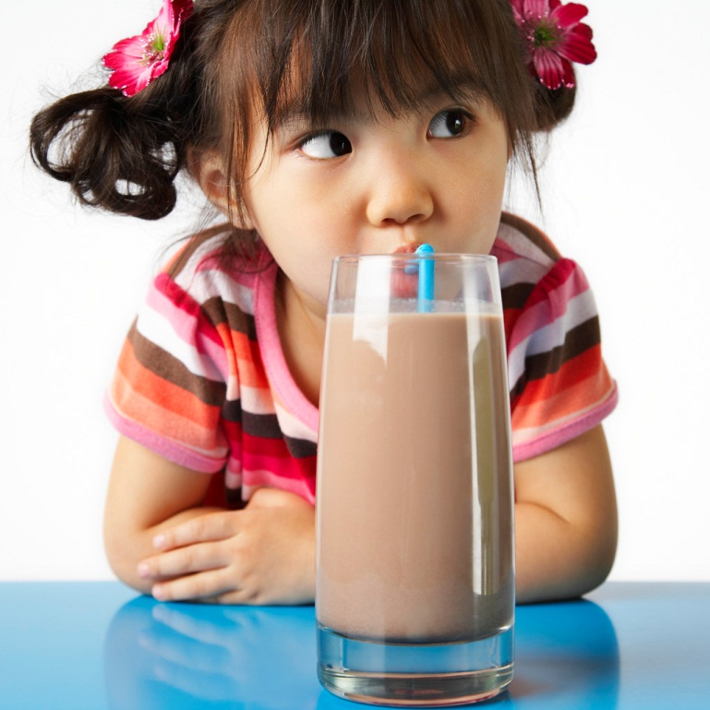
4. Dilute Solution
Dilute: Solution containing a small amount of solute compared with the amount of solvent present
Ex: When MOM makes chocolate milk

Slide 9
5. Concentrated Solution
Concentrated: Solution containing a large amount of solute compared with the amount of solvent present
Ex: When YOU make Chocolate milk!

Slide 10

6. Unsaturated Solution
Unsaturated solution: a solution containing less solute than it can hold at a given temperature
Weak iced tea
This is a DILUTE solution!

Slide 11
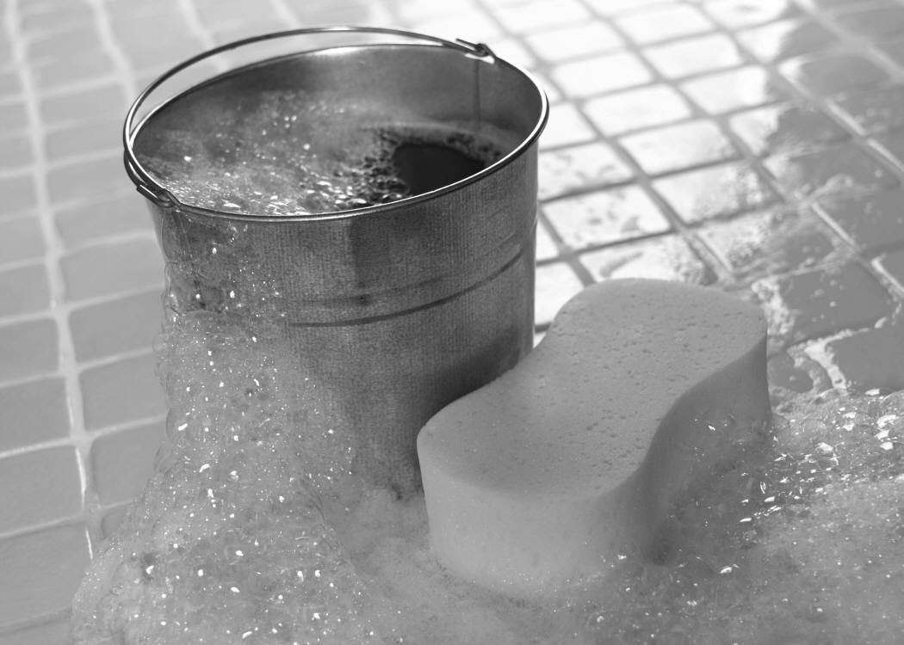
Saturated Solution
Saturated solution: a solution containing all of the solute it can hold at a given temperature
Nothing has settled to the bottom
Think about a sponge just before it leaks!

Slide 12
Supersaturated Solution
Super Saturated Solution: a solution containing more solute than it can normally hold at a given temperature
As the temperature cools, stuff will settle to the bottom; because cool stuff can hold less solute
When stuff settles to the bottom

Slide 13

What is Solubility?
Solubility is the ability of one substance to dissolve in another at a given temperature and pressure.
What does that mean...?
How much stuff can something hold at a specific temperature?

Slide 14

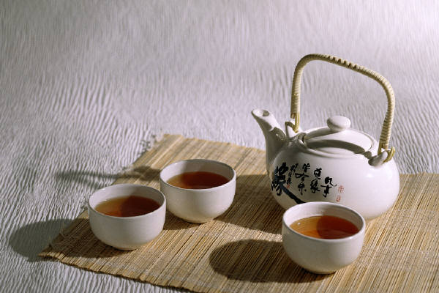
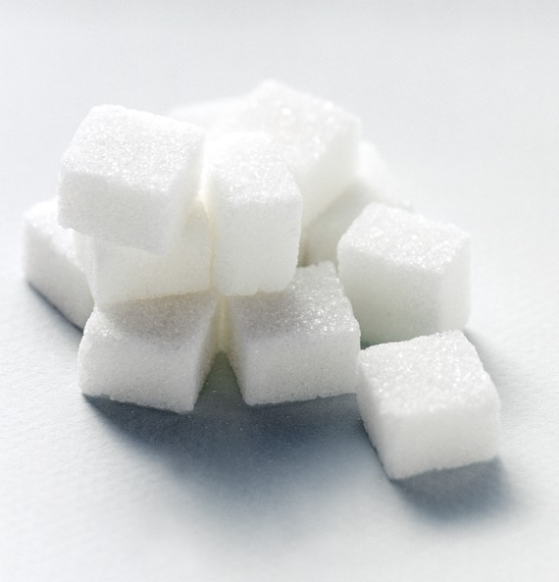
10. How can we increase solubility?
1. Increase the temperature
2. Increase the surface area (smaller pieces dissolve faster than larger pieces)
3. Increase the volume of solvent

Slide 15
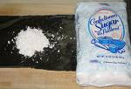


11. How to Change rate of dissolving:
Increase surface area
Stirring
Temperature: Changes not only the amount of the solute that can dissolve but changes how quickly it will dissolve!
Pressure: Which is why a soda bottle emits gas when you open it – you decrease the pressure so it can’t hold as much

Slide 16
Remember….
Temperature will affect how much solute is dissolved in a solvent; how much it CAN hold.
When we increase or decrease temperature how solutions will become saturated, super saturated, unsaturated….
These terms are DESCRIPTIVE, and are used to COMPARE the amount of the solute compared to the solvent!

Slide 17
Remember Kinetic Energy?
As we increase the temperature of something its molecules move faster, which will give more places for a substance to “hide” in a solution.
So the warmer the temperature, the more solute a solvent can hold!
Hot stuff can hold more than cold; think of hot tea vs. iced tea!

Slide 18
4 Classes of Matter
3. ELEMENTS (pure substance):
Fe, S, O, H, N
1. MIXTURES
4. COMPOUNDS (pure substance):
H₂O, SiO₂, CuSO₄
Homogeneous
Heterogeneous
Colloids
2. SOLUTIONS
Can be decomposed by chemical changes:
H₂O 2H + O
Mixtures can be separated by physical changes.

