Slide 1
Introduction to 8th Grade General Science
©Mark Place, 2008-2009
www.LearnEarthScience.com
Edited 2011 - Barbera/Perun

Slide 2
THREE BRANCHES OF SCIENCE
Can you name them?
PHYSICAL SCIENCE: The study of energy. (Example: molecules in motion)
EARTH SCIENCE: The study of the inorganic components of the Earth. (Example: Weather and rocks)
LIFE SCIENCE: The study of living things. (Example: Animals and plants)

Slide 3
BRANCHES OF EARTH SCIENCE
Can you name them?
GEOLOGY: The study of the history of the Earth. (Example: Rocks and plate tectonics)
METEOROLOGY: The study of the Earth’s atmosphere. (Example: Weather and climate)
ASTRONOMY: The study of the Universe. (Example: Stars and space)

Slide 4
How do scientists obtain new information?
Observation
Experimentation
Discovery

Slide 5


Cyclic events
Give three real-life,
earth science, examples
of cyclic events
phases of moon
yearly temperatures
sunspots
tides
sunrise & sunset

Slide 6
Writing Prompt:
Today, I went to the beach and I observed…

Slide 7
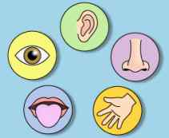

Observations, Inferences, Classification
What is used to make an observation?
the five senses

Slide 8
Writing Prompt
While staring at the sky last night I saw a streak of light, which caused me to infer…

Slide 9
After observations have
been collected.
What does it mean to
make an inference?
make an educated guess
(an hypothesis)

Slide 10
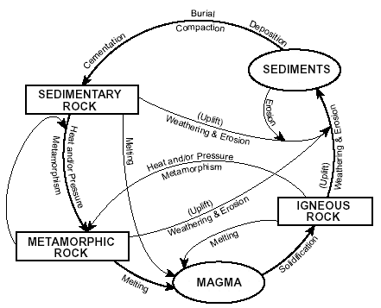

Give examples of how scientists
use classification systems.
Types of Rocks

Slide 11
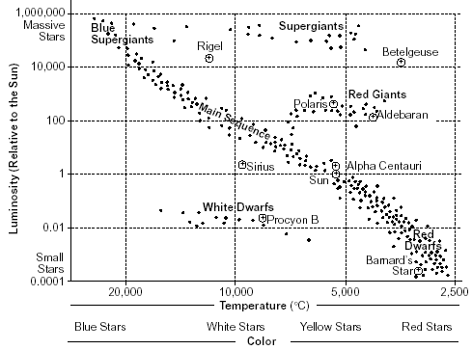
Give examples of how scientists
use classification systems.
Types of Stars

Slide 12
THE STEPS OF THE SCIENTIFIC METHOD
Question (Purpose)
Research
Hypothesis
Experiment
Observation (Analyze Data)
Conclusion
Ask a new question
Repeat Experiment

Slide 13
Controlled Experiment
Controlled experiment – an experiment where the scientist controls all the variables except the ONE variable being tested.
Independent Variable – the variable changed by the scientist.
Dependent Variable – the variable that is not controlled by the scientist. It will be the result of his experiment.
(Ex. If a student eats beans for dinner, then he will pass a lot of gas. (FARTS)
Beans = Independent Variable (Always the IF)
Passing Gas = Dependent Variable (Always the THEN)

Slide 14
Scientific Method Worksheet
Steps:
Hypothesis:
Control vs. variable factors
4. Good experiment has ___ variable and ____control factors!
5. Experimental Group vs. Control Group

Slide 15
Scientific Method Worksheet p. 2
6. Why do we need a control group?
7. Define Independent and Dependent Variable
8. Organize data with ______________
9. Observation v. Inference
10. Large sample size??

Slide 16
Experimental Design Worksheet p. 25 in notes packet
Effect of Aspirin?
Control Group
Experimental Group
If…. Then…
Independent Variable:
Dependent Variable:
List Control Factors

Slide 17
Plant Experiment – p. 26 in notes packet
State Problem
Hypothesis
Control group?
Experimental Group?
Independent Variable?
Dependent Variable?
Some Control Factors?

Slide 18
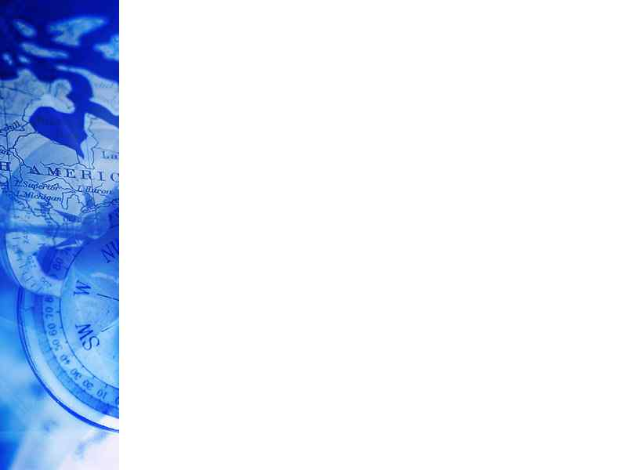

METRIC SYSTEM
International system of measurement based on units of 10.
Length is measure of distance from one point to another.
Unit used to measure LENGTH: METERS (m)
Mass is the amount of matter contained in an object.
Unit used to measure MASS: GRAMS (g)
Volume is the amount of space an object takes up.
Unit used to measure VOLUME: LITERS (l)

Slide 19


Scientific Instruments
 | Common Instrument
Volume of Regular, Rectangular Objects (a box) (meters)
Volume of Irregularly Shaped Objects (rocks)
Mass (grams)
Distance (meters)
Time (minutes, seconds)
ruler
graduated cylinder
Triple beam balance
ruler
stop watch

Slide 20
METRIC CONVERSIONS
K
H
D
U
d
c
m
Kim Helped Dave Until Dave Could Multiply
Or
Kids Help Doing Math During Class Movies

Slide 21
Accuracy
What does it mean if you are asked to record your answer:
a. to the nearest tenth
one decimal place
Example: 0.1
b. to the nearest hundredth
two decimal places
Example: 0.01
to the nearest thousandth
three decimal places
Example: 0.001

Slide 22
Formulas
Density:
D =
M =
V =
D V
M

Slide 23
Conversion Practice
Page 10 – Ruler conversion
Page 11 – Measuring with a ruler
Page 12 – Metric Conversion Worksheet
Page 13 – Metric Conversions Practice

Slide 24

DENSITY
MASS
VOLUME
Notes page 14:
If an object has a mass of 240g on Earth, its mass on the moon
will be (more, less, or the same). Why?
the same
THE NUMBER OF
ATOMS REMAINS
THE SAME

Slide 25
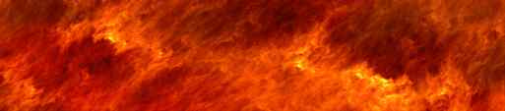
DENSITY
MASS
VOLUME
If an object is cut in half, what
happens to its density? Why?
NOTHING!
If the material stays the same, the density stays the same
EX. Gold Ring vs. Gold Bar
Ex. Hershey’s Kiss vs. Hershey Bar

Slide 26
What happens to the density of an
object when it is split into smaller
parts? why?
Density
nothing!
the atoms are still
packed the same

Slide 27
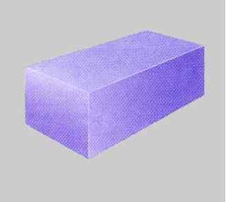

Volume of a regular rectangular object:
What instrument would be used to measure this object’s volume?
ruler

Slide 28

What is the formula for finding the volume of this object?
V = L x W x H
H
W
L

Slide 29
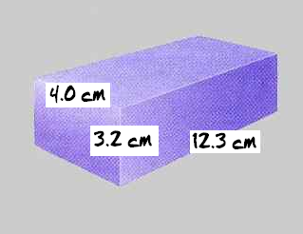
Calculate the volume of this object to the nearest tenth of a centimeter. Show all formulas.
V = L x W x H
V = 4.0cm x 3.2cm x 12.3cm
V= 157.44 cm³

Slide 30
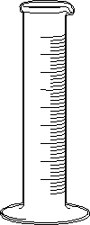
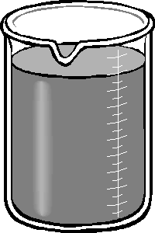

VOLUME of an irregularly
shaped object:
What instrument would be used to measure the volume of an object such as a rock?
graduated cylinder

Slide 31

VOLUME of an irregularly
shaped object:
Describe the process you would use.
Put water into cylinder
measure volume of water
place object in cylinder
re-measure volume of water
subtract volumes

Slide 32
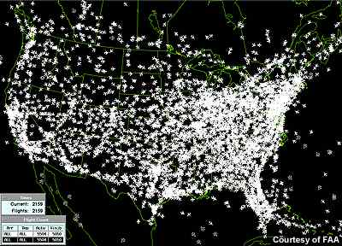
DENSITY:
HOW TIGHTLY PACKED
THE ATOMS ARE
Density

Slide 33
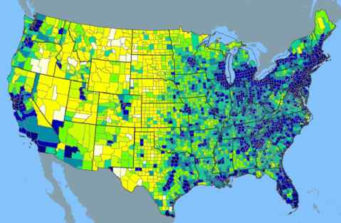
DENSITY:
HOW TIGHTLY PACKED
THE ATOMS ARE
Density

Slide 34
DENSITY NEVER CHANGES unless you
ADD/TAKE AWAY HEAT, or
ADD/TAKE AWAY PRESSURE
Density
When an object is heated, it
and the atoms become
packed. Therefore the object becomes
dense.
expands
less
less

Slide 35
DENSITY NEVER CHANGES unless you
ADD/TAKE AWAY HEAT, or
ADD/TAKE AWAY PRESSURE
Density
When an object is cooled, it
and the atoms become
packed. Therefore the object becomes
dense.
contracts
more
more

Slide 36
Density
density
temperature

Slide 37

Formulas
Density:

Slide 38
Formulas
Density:
D =
M =
V =
Notes page 15
D V
M

Slide 39
Density
What is the formula for density?
density = mass / volume

Slide 40
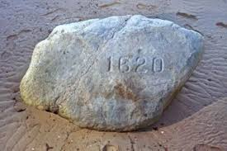
A rock has a mass of 240.0 g and a volume of 12.0cm³.
Determine the density of the rock. (Showing all formulas and calculations)
density = mass / volume
= 240.Og / 12.Ocm³
= 20.0g/cm³

Slide 41
The box below has a mass of 120g.
Showing all formulas and calculations,
determine the density of the box.
volume = L x W x H
Sample Problems
2.0 cm
= 2.0cm x 2.0cm x 10.0cm
10.0 cm
2.0 cm
= 40.0 cm³
Density = mass / volume
Density = 120g / 40cm³
Density = 3.0 g/cm³

Slide 42
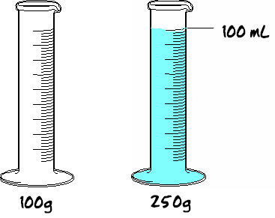
If the empty container has a mass of 100g and
the filled container has a mass of 250g.
What is the density of the liquid inside?
Show all work below.
Sample Problems
mass of liquid
250g – 100g = 150g
250 g
Density of liquid
Density = mass/volume
Density = 150g /100mL = 1.5 g/mL

Slide 43
Density of water:
The density of water
when it is most
dense is:
1.0 g/mL

Slide 44
Density of water:
Float or Sink
Any material with a density
more than water will
Any material with a density
less than water will
SINK
FLOAT

Slide 45

Density of water example:
If an object has a mass of 25g and a volume of 50mL, will it sink or float in liquid water?
D = m ÷ v
= 25g ÷ 50mL
= 0.5 g/mL
it will FLOAT

Slide 46


Phases of Matter & Density
During which phase of matter (solid,
liquid, or gas) are most materials:
most dense?
least dense?
solid
gas

Slide 47

Latitude & Longitude
Notes packet
p. 22 – What is Latitude Do Now/HW
p. 23 – What is Longitude Do Now/HW
p. 24 – Plotting Latitude and Longitude
©Mark Place, 2008-2009
www.LearnEarthScience.com

Slide 48

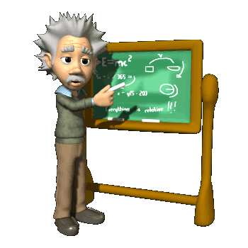
Latitude and Longitude is the coordinate system used to locate any point on Earth.
(example: GPS)
How is latitude measured?

Slide 49
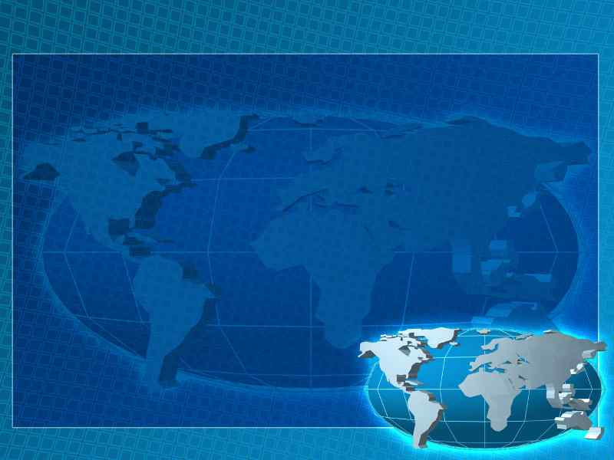
What are Latitude lines?
Latitude lines are parallel to the
Equator

Slide 50
The Equator is the Zero degree line of Latitude :
How is latitude measured?
and
of the
North
South
Equator

Slide 51
Latitude is measured
and
from the
North
South
Equator

Slide 52





180
165
150
135
120
105
90
75
60
45
30
15
0
15
30
45
60
75
90
105
120
135
150
165
180
90
80
E
70
North
60
50
40
30
F
20
10
0
G
10
South
20
30
40
50
60
H
70
80
90

Slide 53
180
165
150
135
120
105
90
75
60
45
30
15
0
15
30
45
60
75
90
105
120
135
150
165
180
90
To get to the next line of
latitude, you must move
in which of two directions?
80
E
70
60
50
40
30
Latitude
F
Equator
20
10
0
G
10
20
30
40
50
60
H
70
80
90

Slide 54
What are Longitude Lines?
Longitude lines connect
the North Pole
to the South Pole
They are NOT
Parallel to each other!

Slide 55
The Prime Meridian is the 0 degree line of longitude
Longitude is measured
and
of the
East
West
Prime Meridian

Slide 56
Longitude
180
165
150
135
120
105
90
75
60
45
30
15
0
15
30
45
60
75
90
105
120
135
150
165
180
90
80
E
70
60
To get to the next line of
longitude, you must move
in which of two directions?
50
40
30
F
20
10
0
G
10
20
30
40
50
60
H
70
80
Prime Meridian
90

Slide 57
180
165
150
135
120
105
90
75
60
45
30
15
0
15
30
45
60
75
90
105
120
135
150
165
180
90
80
E
70
60
50
40
30
F
West
East
20
10
0
G
10
20
30
40
50
60
H
70
80
90

Slide 58
Let’s do some plotting.

Slide 59
On the coordinate system, plot the coordinates given in your notes:
180
165
150
135
120
105
90
75
60
45
30
15
0
15
30
45
60
75
90
105
120
135
150
165
180
90
80
E
70
D
60
A
50
40
30
F
20
10
0
G
B
10
20
30
C
40
50
60
H
70
80
90

Slide 60
State the coordinates for each of the letters in the figure above:
180
165
150
135
120
105
90
75
60
45
30
15
0
15
30
45
60
75
90
105
120
135
150
165
180
90
20°N, 75°E
80
E
70
60
65°N, 50°W
50
40
F
30
20
10
0
G
10
70°S, 15°E
20
30
10°S, 135°W
40
50
H
60
70
80
90

Slide 61

LONGITUDE
Notes page 20
BASED ON EARTH’S
ROTATION

Slide 62
LONGITUDE
EACH HOUR,
EARTH ROTATES
15°
(360°/24hrs)

Slide 63
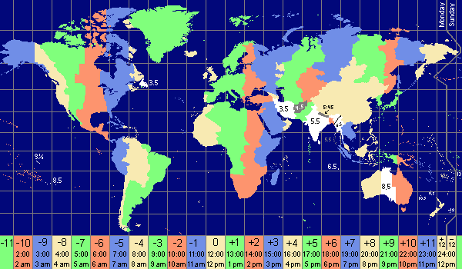
HOW MANY TIME ZONES?

Slide 64
HOW MANY TIME ZONES?
24 TIME ZONES
15° APART

Slide 65
People on the
same line of
longitude have
the same
Local Time

Slide 66
Example: Two students record a
difference in local time of two
hours. How many degrees of
longitude apart are they?
15° x 2 hours = 30°

Slide 67
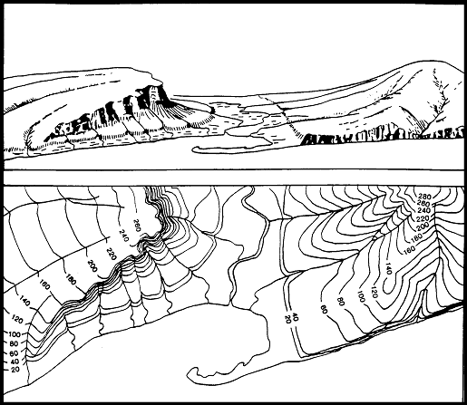
Topography / Contour Maps
Elevation of the land (hills and valleys)

Slide 68
What is the purpose?
To show the Elevation of the land (hills and valleys) above and below sea level

Slide 69
Who uses topographic maps?
the military
miners
police
farmers

Slide 70

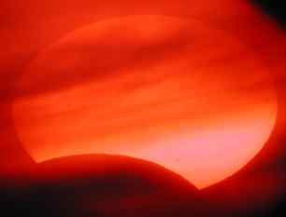
When might someone
use a topographic
map?
building homes
plan a hiking trip
landscaping
road building

Slide 71
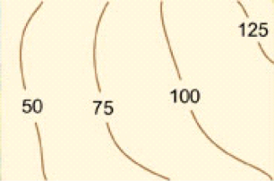
Map 1 Practice
Contour Interval?
25
X

Slide 72
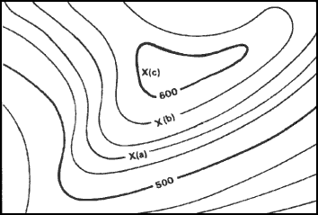


Contour
Interval?
20
Elevation of "A"?
540
Elevation of "B"?
580

Slide 73
Lines close together =
STEEP SLOPE
Lines far apart =
Gentle SLOPE
Highest possible elevation?
619

Slide 74
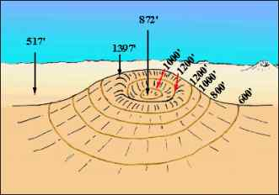
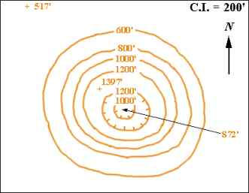
What do hachured
lines show?
areas of
depression

Slide 75
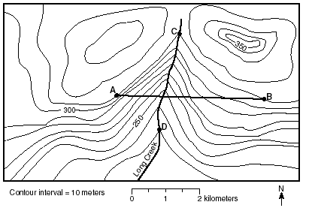


If north is at the
top of the page, what direction
is this river flowing?
south

Slide 76
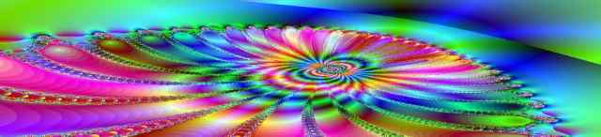

Can a river flow north?
yes!
Rivers always flow DOWNHILL – NO MATTER WHAT DIRECTION is downhill due to GRAVITY
Ex. Nile River (Northern Africa) and Red River (US)

Slide 77
Name two ways that you can
determine which
way a river flows
on a topographic map.
contour lines point
upstream
rivers flow
downhill

Slide 78
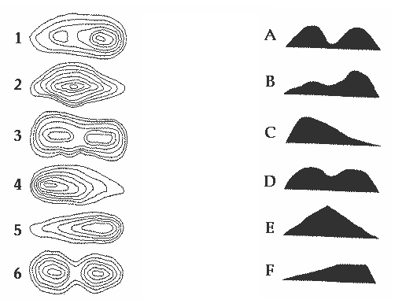
Please match the contour map on the left with the profile on the right.

