Slide 1
Minerals
Unit 2
Rocks and Minerals

Slide 2
Characteristics of Minerals:
Occur naturally in the Earth
Inorganic – not formed by living things
Solid
Have a Crystal structure – atoms or molecules are arranged in a repeating pattern
Can be an element or a compound:
Examples:
Elements – Gold (Au), Silver (Ag), Copper (Cu)
Compounds – Halite (NaCl), Quartz (SiO₂)

Slide 4
Two Major Groups of Minerals
Silicate Minerals – contain a combination of Silicon (Si) and Oxygen (O). Make up more than 90% of the Earth’s crust.
Nonsilicate Minerals – do NOT contain BOTH Silicon and Oxygen.

Slide 5
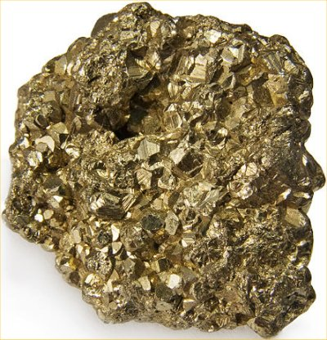
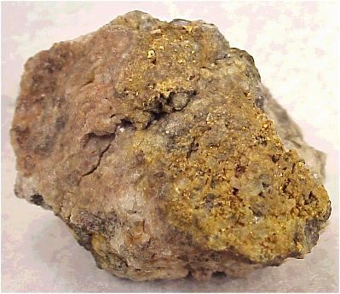
Identification of Minerals
1.Color
Not the most reliable method
Example: Fools Gold vs. Gold

Slide 6
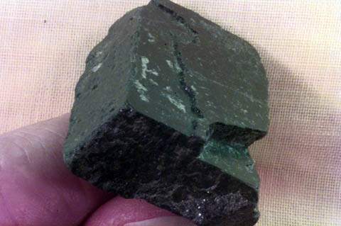
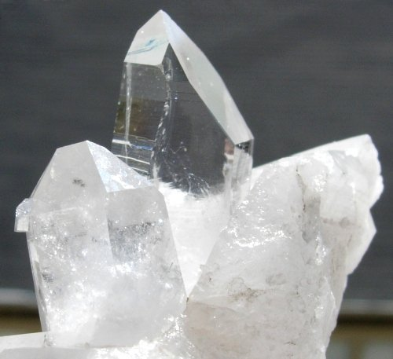
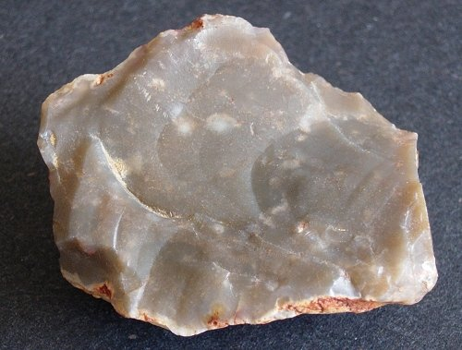
2. Luster
How a mineral reflects light
Metallic luster – shiny
Non-metallic luster – can be dull, glassy or waxy

Slide 7
3.Streak
Color of a mineral in powdered form
Found by rubbing mineral on a streak plate (unglazed porcelain)
Streak is not always the same color as the mineral

Slide 8
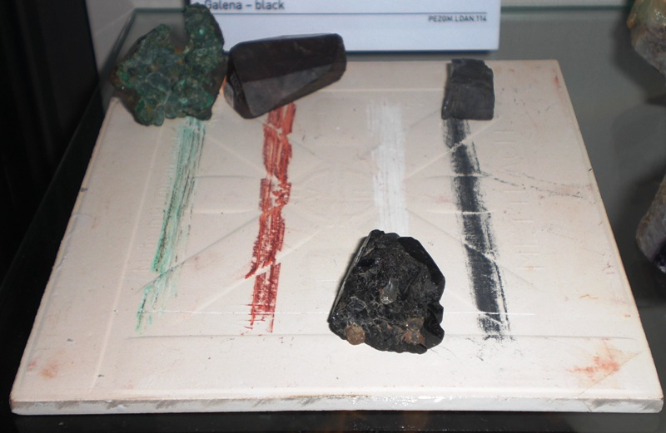

Slide 9
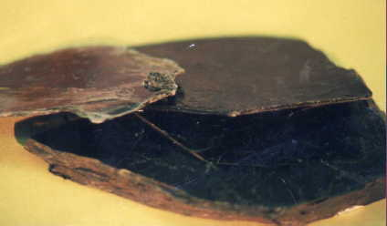
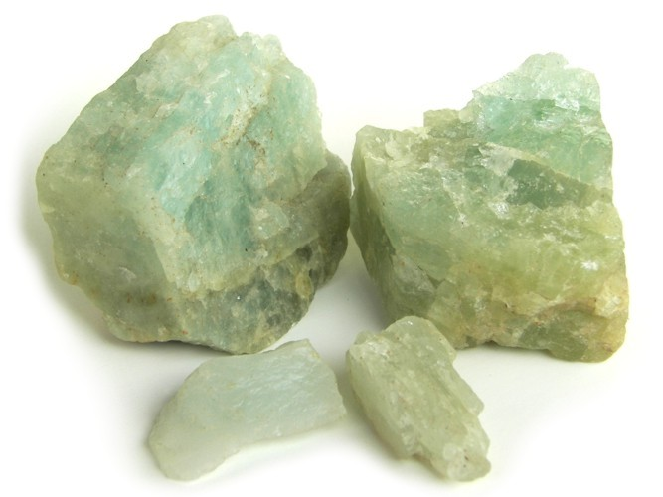
4. Cleavage and Fracture
How a mineral breaks
Cleavage – breaks along smooth, flat surface
Fracture – breaks unevenly along curved, irregular surface

Slide 10
5. Hardness
A mineral’s resistance to being scratched
Measured by the Moh’s Hardness Scale which ranges from 1 (softest) Talc to 10 (hardest) Diamond

Slide 11
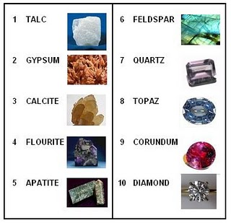
Moh’s Hardness Scale

Slide 12
Special Properties of Minerals
May include:
Flourescence – glows under UV light
Fluorescence Youtube Video (3:00)
Magnetism
Chemical Reaction – bubbles when an acid is placed on it
Chemical Reaction Youtube (:20 seconds)
Taste – not recommended
Radioactivity

Slide 13
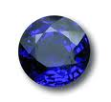
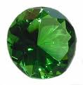
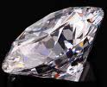
Some uses of Minerals
Ores:
Mineral deposits large enough to be mined for profit.
Gems:
Rare and beautiful minerals that are hard enough to be cut and polished.

